Slide 1
Idea:
Children Health Awareness:
Children are vulnerable to malnutrition and diseases, they are too attracted to junk foods & in-take large amount of junk foods without awareness leads to many severe diseases.
Our idea is to give some information about food which has to be taken and not to in-take, and make awareness about it to lead a healthy long living life.

Slide 2
Technical Stack & Use Cases:
HTML & CSS.
Carbohydrates:
It is essential for proper body functioning.
They are sugars,fibres or starches that provide energy for all the cells and tissues in the body.Carbohydrates also ensure our body is not breaking down proteins to gain energy,preventing loss of muscle mass.
Ex: Quinoa,Brown Rice,Vegetables,Bread, and fruits,barley.

Slide 3
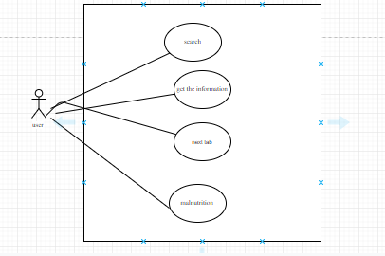
Use case

